Slide 1
Module 6: Architectural Design
Software Engineering
School of Computing, Faculty of Engineering
Universiti Teknologi Malaysia

Slide 2
Outline
Architectural Design and Detailed Design
Architectural Design Decision
Architectural View
Architectural Pattern
  Model-View-Controller (MVC)
  Layered
  Repository
  Client-Server
  Pipe and Filter
Application Architectures
Note: The overall contents of the slide are based on the main reference that is Sommerville (2016) with other references specified directly in respective slides (if any)

Slide 3
Objectives
To know the purpose of design and the difference between architectural and detailed design (use case realization)
To understand the architectural design decision
To know differences in architectural views and representation using UML diagrams (deployment diagram and details of component diagram)
To identify the use of different architectural patterns

Slide 4
Architectural design and detailed design
Overview

Slide 5
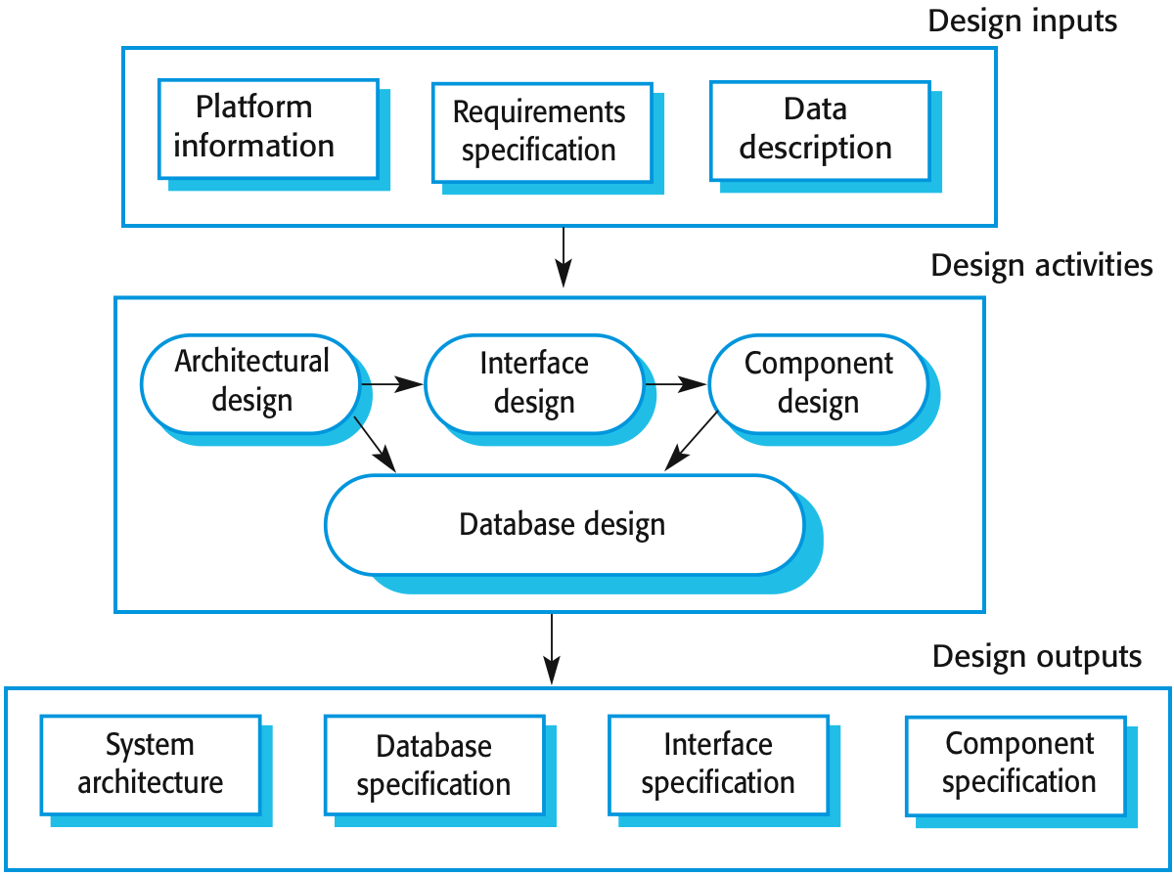
Recap on Design Stage

Slide 6
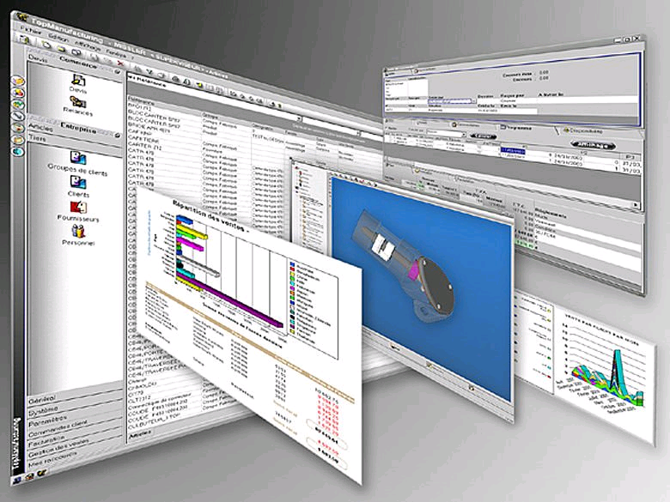
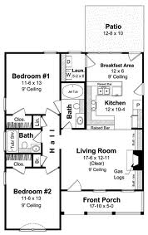
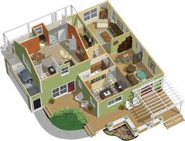
Architecture Analogy for
Software vs. House?

Slide 7
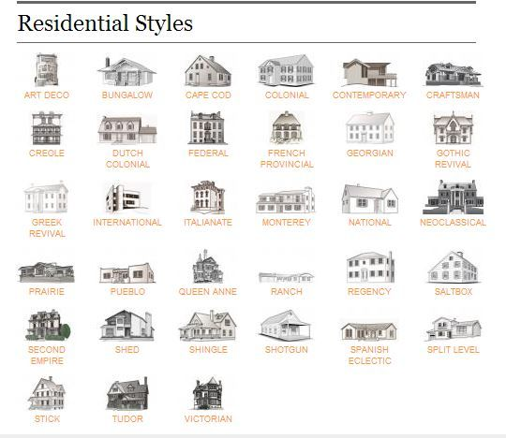
Analogy: Residential Styles

Slide 8
Design Discipline Activities
Segmented into 6 major activities:
  Design the support services architecture and deployment environment →(network course)
  Design the software architecture →focus of SE lecture
  Design the use case realizations →focus of SE lecture
  Design the database → (database course)
  Design the system and user interfaces (HCI course)
  Design the system security and controls (network security; database security)

Slide 9
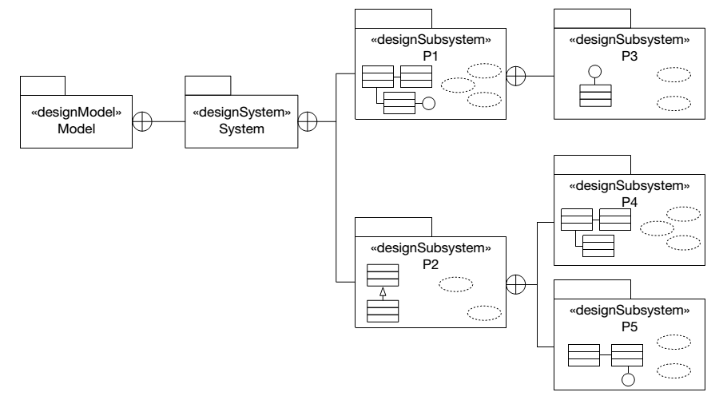
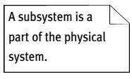
From Analysis to Design:
Design Artefacts Metamodel
Design model contains exactly one design system that contains many design subsystems (also known as “package” that can also be introduced in the analysis)
Source: Arlow and Neustadt (2002)

Slide 10
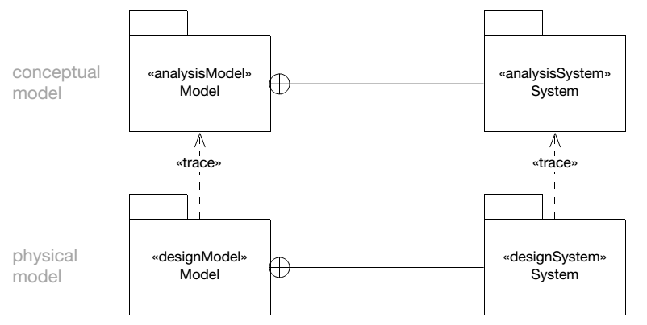
Relationships between Analysis and Design (Model and System)
There is a simple «trace» relationship between the analysis and design models – the design model is based on the analysis model, and can be considered to be just a refinement and elaboration thereof
Similarly, there is a simple, one-to-one «trace» relationship between the analysis system and the design system
Source: Arlow and Neustadt (2002)

Slide 11
Architectural Design: Design the Software Architecture
Architectural design is concerned with understanding how a software system should be organized and designing the overall structure of that system
Architectural design is the critical link between design and requirements engineering, as it identifies the main structural components in a system and the relationships between them
The output of the architectural design process is an architectural model that describes how the system is organized as a set of communicating components

Slide 12
Design Use Case Realizations
Use case realizations offer a lower-level view
Two-tiered focus:
  Class interactions supporting a particular use case
  Interactions among software, users, and external systems
Design typically spread over many iterations
UML design class diagrams and interaction diagrams (sequence diagram) ➔ document design [to be elaborated in Module 7]

Slide 13
Example: Architecture of a Packing Robot Control System

Slide 14
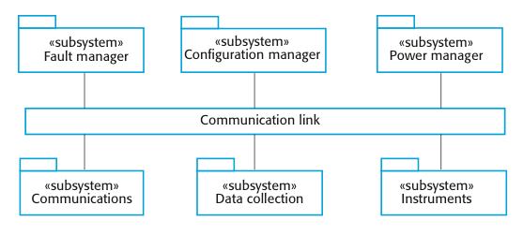
Example: High Level Architecture of Weather Station System

Slide 15
Architectural Abstraction
Architecture in the small is concerned with the architecture of individual programs
  Concerned with the way that an individual program is decomposed into components
Architecture in the large is concerned with the architecture of complex enterprise systems that include other systems, programs, and program components
  These enterprise systems are distributed over different computers, which may be owned and managed by different companies

Slide 16
Advantages of Explicit Architecture
Stakeholder communication
  Architecture may be used as a focus of discussion by system stakeholders
System analysis
  Means that analysis of whether the system can meet its non-functional requirements is possible
Large-scale reuse
  The architecture may be reusable across a range of systems
  Product-line architectures may be developed

Slide 17
Architectural Representations
Simple, informal block diagrams showing entities and relationships are the most frequently used method for documenting software architectures
But these have been criticised because they lack semantics, do not show the types of relationships between entities nor the visible properties of entities in the architecture
Depends on the use of architectural models, the requirements for model semantics depends on how the models are used

Slide 18
Box and Line Diagrams
Very abstract - they do not show the nature of component relationships nor the externally visible properties of the sub-systems
However, useful for communication with stakeholders and for project planning

Slide 19
Use of Architectural Models
As a way of facilitating discussion about the system design
  A high-level architectural view of a system is useful for communication with system stakeholders and project planning because it is not cluttered with detail
  Stakeholders can relate to it and understand an abstract view of the system, then discuss the system as a whole without being confused by detail
As a way of documenting an architecture that has been designed
  The aim here is to produce a complete system model that shows the different components in a system, their interfaces and their connections

Slide 20


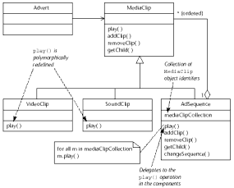
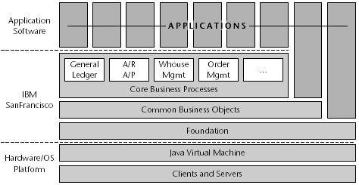


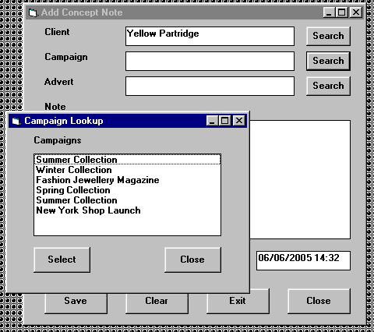
Enterprise Architecture
Alignment of IT architecture to business strategy and structure, and existing IT
Agate Boundary
sd Broker-based client–server communication
Agate Control Client
:Client
:ClientSide
Proxy
:Broker
:ServerSide
Proxy
:Server
callServer
sendRequest
packData
Agate Control Server
sendRequest
findServer
requestService
unpackData
Agate Domain
service
response
Agate Business
Objects
Agate Value
Objects
sendResponse
sendResponse
packData
Agate Database
response
unpackData
Meeting users’ requirements and determining the high-level structure of the system
Global
Catalogue
Data
Local Data
Catalogues
Data
Choosing technologies and frameworks, setting standards, and applying patterns
Detailed Design
Agate Boundary
Agate Control Client
CheckCampaignBudgetUI
CheckCampaignBudgetClient
ListCampaigns
«interface»
java::awt::event::ItemListener
+ listAllCampaigns(CampaignLister)
+ listCampaigns(CampaignLister, Client)
+ itemStateChanged(ItemEvent)
Agate Entity
Agate Control Server
«use»
Agate Domain
ListClients
ListCampaigns
sd Check campaign budget
«interface»
CampaignLister
CheckCampaignBudgetUI
+ addCampaignName(String)
+ clearAllCampaignNames( )
+ removeCampaignName(String)
- clientLabel : JLabel
Client
Campaign
CheckCampaignBudgetServer
:CheckCampaign
Budget
- campaignLabel : JLabel
CheckCampaignBudget
- budgetLabel : JLabel
- checkButton : JButton
ControllerFactory
:CheckCampaign
BudgetUI
- closeButton : JButton
Advert
CheckCampaign
BudgetUI( this )
- budgetTextField : JTextField
:ListClients
- clientComboBox : JComboBox
ccbUI :=
CheckCampaignBudgetUI
ListClients
«interface»
ClientLister
- campaignComboBox : JComboBox
loop
lc := ListClients
+ enable( )
+ enableCheckButton( )
+ getSelectedClient( )
+ getSelectedCampaign( )
+ setBudget(Currency)
+ addCampaignName(String)
+ clearAllCampaignNames( )
+ removeCampaignName(String)
+ addClientName(String)
+ clearAllClientNames( )
+ removeClientName(String)
+ itemStateChanged(ItemEvent)
[For all clients]
listAllClients( ccbUI )
+ addClientName(String)
+ clearAllClientNames( )
+ removeClientName(String)
Agate Data Management
enable
addClientName( name )
«use»
RelationalBroker
disableCampaignList
ListClients
ClientBroker
CampaignBroker
disableCheckButton
+ listAllClients(ClientLister)
AdvertBroker
Designing user interfaces, interactions, classes, data storage
© 2010 Bennett, McRobb and Farmer

Slide 21
Architectural design decision

Slide 22
Architectural Design Decision
Architectural design is a creative process, so the process differs depending on the type of system being developed
However, a number of common decisions span all design processes and these decisions affect the non-functional characteristics of the system

Slide 23
Architectural Design Decision

Slide 24
Architecture Reuse
Systems in the same domain often have similar architectures that reflect domain concepts
Application product lines are built around a core architecture with variants that satisfy particular customer requirements
The architecture of a system may be designed around one of more architectural patterns or ‘styles’ to capture the essence of an architecture and can be instantiated in different ways

Slide 25
Architecture and System Characteristics (Non-Functional Requirements)
Performance
  Localise critical operations and minimise communications
  Use large rather than fine-grain components
Security
  Use a layered architecture with critical assets in the inner layers
Safety
  Localise safety-critical features in a small number of sub-systems
Availability
  Include redundant components and mechanisms for fault tolerance
Maintainability
  Use fine-grain, replaceable components

Slide 26
Architectural view
4+1 View Model

Slide 27
Architectural Views
What views or perspectives are useful when designing and documenting a system’s architecture?
What notations should be used for describing architectural models?
Each architectural model only shows one view or perspective of the system
  It might show how a system is decomposed into modules, how the run-time processes interact or the different ways in which system components are distributed across a network
  For both design and documentation, we usually need to present multiple views of the software architecture

Slide 28
Architectural Views

Slide 29
4 + 1 View Model of Software Architecture
Logical view shows the key abstractions in the system as objects or object classes
Process view shows how, at run-time, the system is composed of interacting processes
Development (or implementation) view shows how the software is decomposed for development
Physical (or deployment) view shows the system hardware and how software components are distributed across the processors in the system
Related using use cases or scenarios (+1)

Slide 30
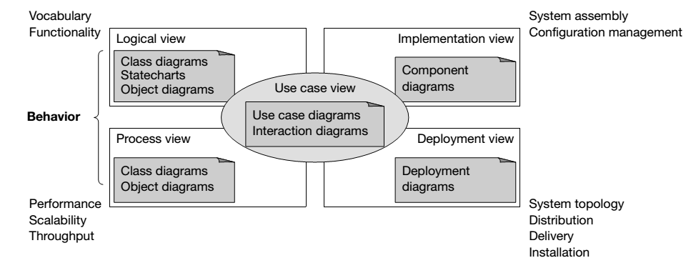
UML Diagrams to Represent Architectural Views (4+1 View Model)
Source: Kruchten (2000) in Arlow and Neustadt (2002)
Note: Sommerville (2016) states implementation view as development view, while deployment view as physical view

Slide 31
From Design to Implementation
The key artefact of the implementation workflow from the point of view of the OO analyst or designer is the implementation model
This model consists of 2 types of diagram:
  Component diagram: models the dependencies between the software components that constitute the system
  Deployment diagram: models the physical computational nodes on which the software will be deployed, and the relationships between those nodes
Source: Arlow and Neustadt (2002)

Slide 32
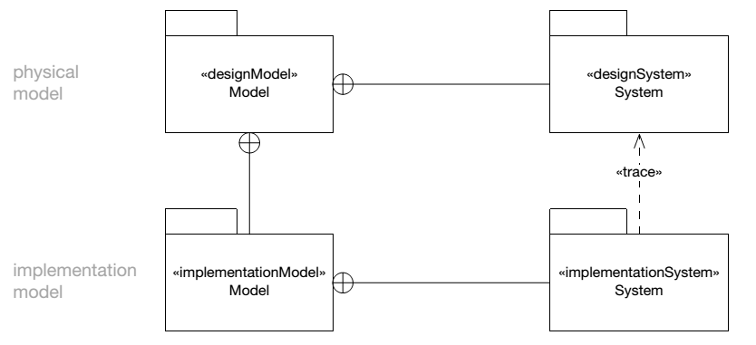
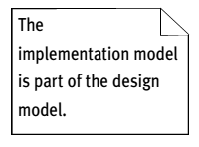
Relationship between Implementation Model and Design Model
Implementation model is really just the implementation view of a design model i.e. it is part of the design model, see the relationship <<trace>>

Slide 33
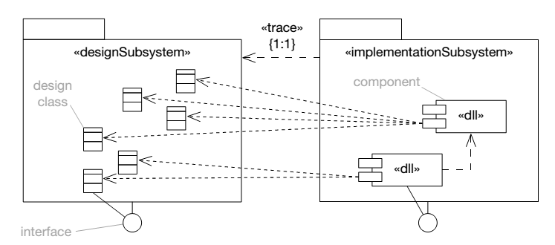
Relationship between Design Subsystems and Implementation Subsystems
There is a one-to-one «trace» relationship between design subsystems and implementation subsystems
Design subsystems contain design classes but implementation subsystems contain components that package those classes

Slide 34
Component diagram as an implementation view
Existing framework, legacy system, existing system, hardware driver, Web service provider

Slide 35
UML Component Diagram
Used to model the top-level view of the system design in terms of components and dependencies among the components
Components can be linkable libraries, executables
Components can be identified based on influence from the system environment e.g. existing framework used for the software, connection to legacy system or external system, hardware driver used and also if the software used any web service available
Source: Bennett, McRobb and Farmer (2010)

Slide 36
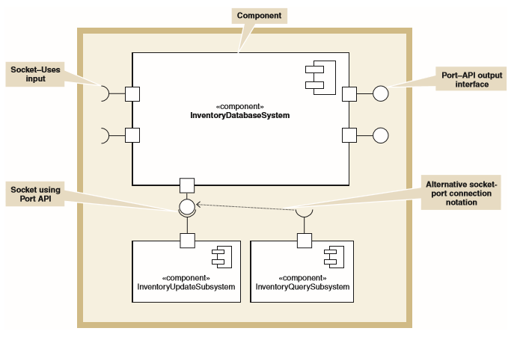
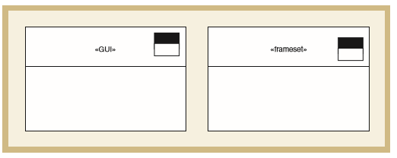
UML Component Notation and Extension Notation for Windows and Web page
Source: Satzinger (2011)

Slide 37
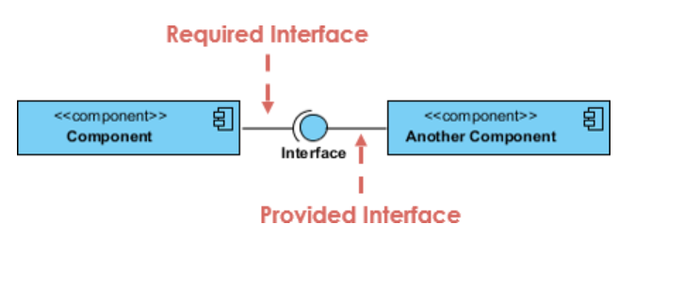
Types of Interface in Components
A UML interface describes a group of operations used or created by UML components
2 types of interfaces: provided and required interfaces:
  A provided interface is modeled using the lollipop notation
  A required interface is modeled using the socket notation
Source: Bennett, McRobb and Farmer (2010)

Slide 38
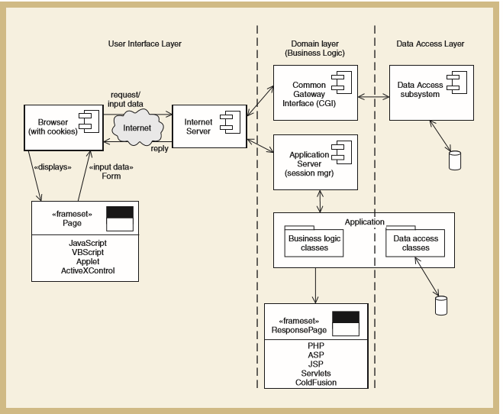
Influence from the System Environment: Existing Framework
Choice of OS, database and programming language and the way to which the new components will be chosen, designed and interconnected
e.g. adopting J2EE or Microsoft.NET will expect the new system to fit the framework
Component diagram based on web based system framework

Slide 39
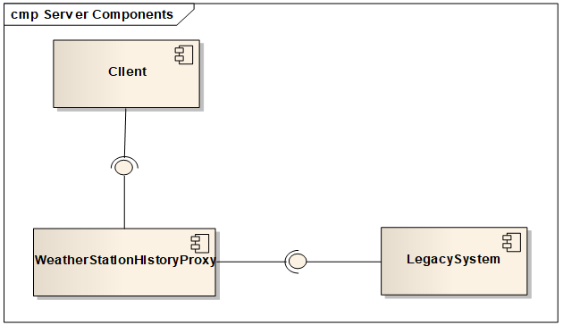
Influence from the System Environment: Legacy System
The technology used to develop them are out of date and difficult to support
The system operates on out of date technology but still have a clear benefit to the business
The new system need to access the data from legacy system using a wrapper

Slide 40
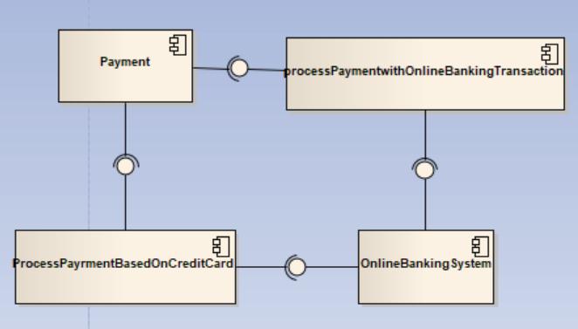
Influence from the System Environment: External System
The new system needs data from the external system
Have to be connected to the external system provided service

Slide 41
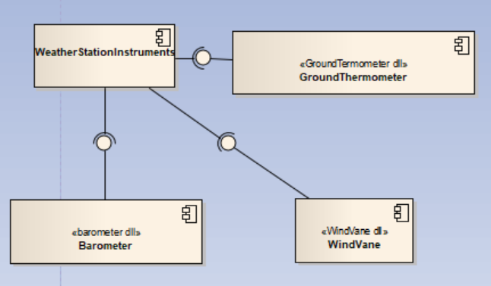
Influence from the System Environment: Hardware Driver
If there is hardware involved especially the usage of sensor or actuator, a dll library is needed as a component driver to link the hardware to the new system

Slide 42
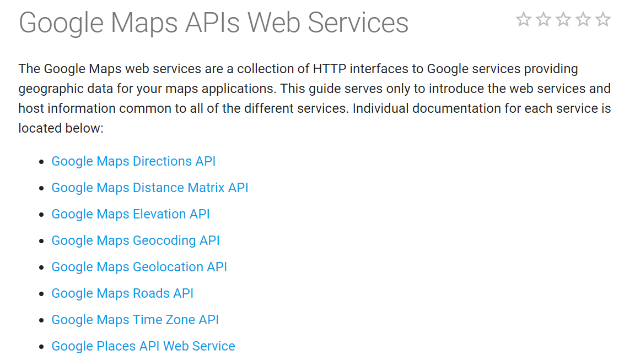
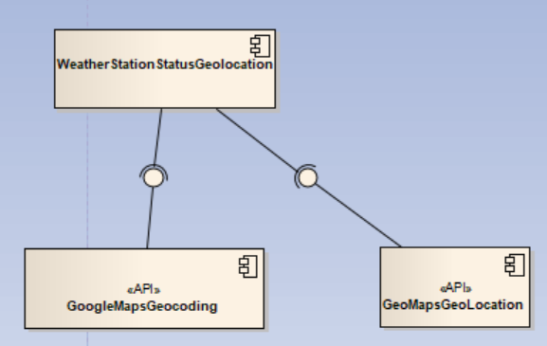
Influence from the System Environment: Web Service
The new system needs an available API from a Web service

Slide 43
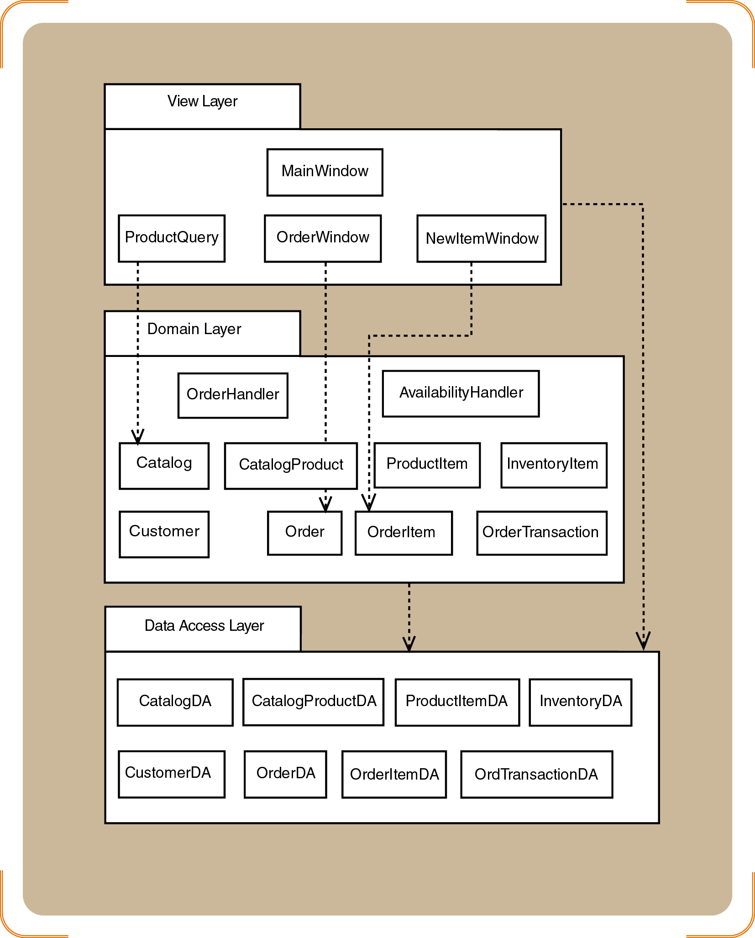
Combination of Architectural Style: Layered, Subystems and Components

Slide 44
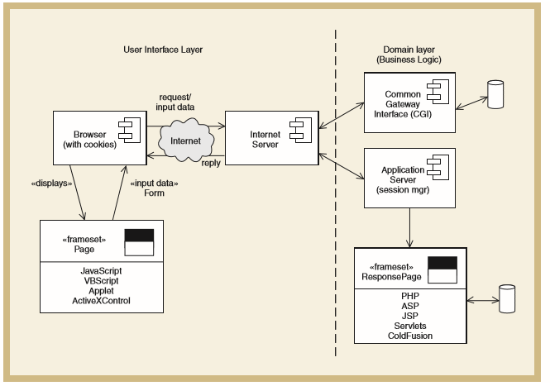
Example: Two-Layer Architectural Design of Internet Systems
Source: Satzinger (2011)

Slide 45
Example: Three-Layer Architectural Design of Internet Systems
Source: Satzinger (2011)

Slide 46
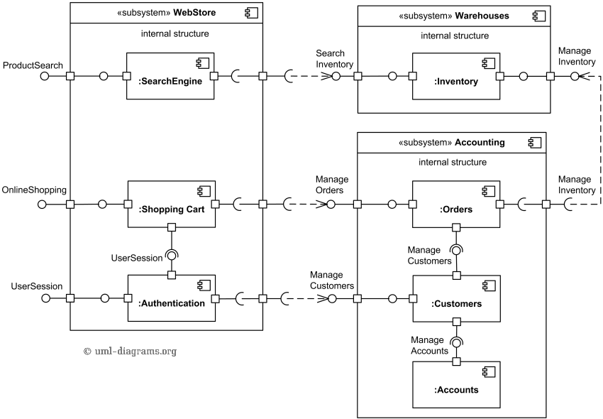
Example: Component Diagram for Online Shopping
Source: https://www.uml-diagrams.org/examples/online-shopping-uml-component-diagram-example.html

Slide 47
Architectural pattern
Model-View-Controller (MVC), Layered, Repository, Client-Server, Pipe and Filter

Slide 48
Architectural Patterns
Patterns (also known as styles) are a means of representing, sharing and reusing knowledge
An architectural pattern is a stylized description of good design practice, which has been tried and tested in different environments
Patterns should include information about when they are and when they are not useful
Patterns may be represented using tabular and graphical descriptions

Slide 49
Common Architectural Patterns
Model-View-Controller (MVC)
Layered
Repository
Client-Server
Pipe and Filter

Slide 50
Model-View-Controller (MVC) Pattern
Name | MVC (Model-View-Controller)
Description | Separates presentation and interaction from the system data. The system is structured into three logical components that interact with each other. The Model component manages the system data and associated operations on that data. The View component defines and manages how the data is presented to the user. The Controller component manages user interaction (e.g., key presses, mouse clicks, etc.) and passes these interactions to the View and the Model.
Example | The architecture of a web-based application system organized using the MVC pattern (see the example slide).
When used | Used when there are multiple ways to view and interact with data. Also used when the future requirements for interaction and presentation of data are unknown.
Advantages | Allows the data to change independently of its representation and vice versa. Supports presentation of the same data in different ways with changes made in one representation shown in all of them.
Disadvantages | Can involve additional code and code complexity when the data model and interactions are simple.

Slide 51
Organization of MVC

Slide 52
Web Application Architecture Using MVC

Slide 53
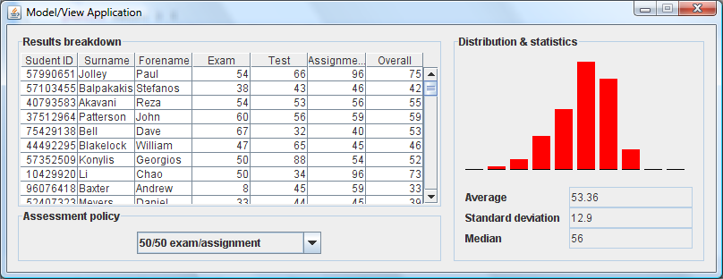
Example: MVC Architecture Used for a Dashboard
Many desktop applications provide multiple views of some data model.
Invariant : all views should offer a mutually consistent representation of the model.
Graphical view
JTable component
instance
Model
Change request
Stats view
JCombobox component
instance
Update notification
Adopted from University of Auckland

Slide 54
Layered Architecture
Used to model the interfacing of sub-systems
Organises the system into a set of layers (or abstract machines) each of which provide a set of services
Supports the incremental development of sub-systems in different layers
When a layer interface changes, only the adjacent layer is affected
As layered systems localize machine dependencies, this makes it easier to provide multi-platform implementations of an application system

Slide 55
Layered Architecture Pattern
Name | Layered architecture
Description | Organizes the system into layers with related functionality associated with each layer. A layer provides services to the layer above it so the lowest-level layers represent core services that are likely to be used throughout the system. See next slide.
Example | A layered model of a system for sharing copyright documents held in different libraries, as shown in the iLearn example slide.
When used | Used when building new facilities on top of existing systems; when the development is spread across several teams with each team responsibility for a layer of functionality; when there is a requirement for multi-level security.
Advantages | Allows replacement of entire layers so long as the interface is maintained. Redundant facilities (e.g., authentication) can be provided in each layer to increase the dependability of the system.
Disadvantages | In practice, providing a clean separation between layers is often difficult and a high-level layer may have to interact directly with lower-level layers rather than through the layer immediately below it. Performance can be a problem because of multiple levels of interpretation of a service request as it is processed at each layer.

Slide 56
Generic Layered Architecture

Slide 57
Example: Architecture of iLearn System

Slide 58
Example: Architecture of Mentcare System

Slide 59
Three and Four Layer Architectures
Presentation
Presentation
Business logic layer can be split into 2 layers
Application logic
Business logic
Domain
Database
Database
Source: Bennett, McRobb and Farmer (2010)

Slide 60
Example: Partitioned Subsystems in Four Layer Architecture
Loosely coupled subsystems, each delivering a single service or coherent group of services
Presentation
layer
Advert
HCI Subsystem
Campaign Costs
HCI Subsystem
E.g. Agate campaign management system
Application
layer
Advert
Subsystem
Campaign Costs
Subsystem
Campaign Domain
A single domain
layer supports
two application
subsystems
Campaign Database
Source: Bennett, McRobb and Farmer (2010)

Slide 61
Repository Architecture
Sub-systems must exchange data that may be done in two ways:
  Shared data is held in a central database or repository and may be accessed by all sub-systems
  Each sub-system maintains its own database and passes data explicitly to other sub-systems
When large amounts of data are to be shared, the repository model of sharing is most commonly used a this is an efficient data sharing mechanism

Slide 62
Repository Pattern
Name | Repository
Description | All data in a system is managed in a central repository that is accessible to all system components. Components do not interact directly, only through the repository.
Example | An example of an IDE (see next slide) where the components use a repository of system design information. Each software tool generates information which is then available for use by other tools.
When used | Should use this pattern when we have a system in which large volumes of information are generated that has to be stored for a long time. May also use it in data-driven systems where the inclusion of data in the repository triggers an action or tool.
Advantages | Components can be independent—they do not need to know of the existence of other components. Changes made by one component can be propagated to all components. All data can be managed consistently (e.g., backups done at the same time) as it is all in one place.
Disadvantages | The repository is a single point of failure so problems in the repository affect the whole system. May be inefficiencies in organizing all communication through the repository. Distributing the repository across several computers may be difficult.

Slide 63
Example: Repository Architecture for an IDE

Slide 64
Example: Repository Architecture for Language Processing System

Slide 65
Client-Server Architecture
Distributed system model which shows how data and processing is distributed across a range of components
  Can be implemented on a single computer
Set of stand-alone servers which provide specific services such as printing, data management, etc.
Set of clients which call on these services
Network which allows clients to access servers

Slide 66
Client-Server Pattern
Name | Client-server
Description | In a client–server architecture, the functionality of the system is organized into services, with each service delivered from a separate server. Clients are users of these services and access servers to make use of them.
Example | Example of a film and video/DVD library organized as a client–server system (see next slide).
When used | Used when data in a shared database has to be accessed from a range of locations. Because servers can be replicated, may also be used when the load on a system is variable.
Advantages | The principal advantage of this model is that servers can be distributed across a network. General functionality (e.g. a printing service) can be available to all clients and does not need to be implemented by all services.
Disadvantages | Each service is a single point of failure so susceptible to denial of service attacks or server failure. Performance may be unpredictable because it depends on the network as well as the system. May be management problems if servers are owned by different organizations.

Slide 67
Example: Client-Server Architecture for Film Library

Slide 68
Pipe and Filter Architecture
Functional transformations process their inputs to produce outputs
May be referred to as a pipe and filter model (as in UNIX shell)
Variants of this approach are very common
When transformations are sequential, this is a batch sequential model which is extensively used in data processing systems
Not really suitable for interactive systems

Slide 69
Pipe and Filter Pattern
Name | Pipe and filter
Description | The processing of the data in a system is organized so that each processing component (filter) is discrete and carries out one type of data transformation. The data flows (as in a pipe) from one component to another for processing.
Example | Example of a pipe and filter system used for processing invoices (see next slide).
When used | Commonly used in data processing applications (both batch- and transaction-based) where inputs are processed in separate stages to generate related outputs.
Advantages | Easy to understand and supports transformation reuse. Workflow style matches the structure of many business processes. Evolution by adding transformations is straightforward. Can be implemented as either a sequential or concurrent system.
Disadvantages | The format for data transfer has to be agreed upon between communicating transformations. Each transformation must parse its input and unparse its output to the agreed form. This increases system overhead and may mean that it is impossible to reuse functional transformations that use incompatible data structures.

Slide 70
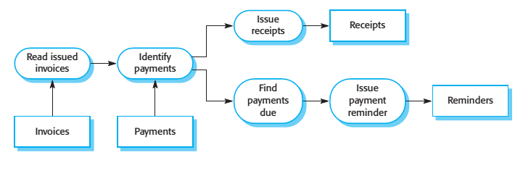
Example: Pipe and Filter Architecture Used in Payments System

Slide 71
Example: Pipe and Filter Used for Compiler Architecture

Slide 72
APPLICATION ARCHITECTURES
Transaction Processing System, Information Systems, Language processing system,

Slide 73
Application Architectures
Application systems are intended to meet a business or an organizational need.
Therefore, as well as general business functions, all phone companies need systems to connect and meter calls, manage their network and issue bills to customers.
Consequently, the application systems used by these businesses also have much in common.
The application architecture may be reimplemented when developing new systems.
However, for many business systems, application architecture reuse is implicit when generic application systems are configured to create a new application.

Slide 74
Used of Model Application Architectures
As a starting point for the architectural design process If you are unfamiliar with the type of application that you are developing, you can base your initial design on a generic application architecture. You then specialize this for the specific system that is being developed.
As a design checklist If you have developed an architectural design for an application system, you can compare this with the generic application architecture. You can check that your design is consistent with the generic architecture.
As a way of organizing the work of the development team The application architectures identify stable structural features of the system architectures, and in many cases, it is possible to develop these in parallel.

Slide 75
Used of Model Application Architectures…cont
As a means of assessing components for reuse If you have components you might be able to reuse, you can compare these with the generic structures to see whether there are comparable components in the application architecture.
As a vocabulary for talking about applications If you are discussing a specific application or trying to compare applications, then you can use the concepts
Example of application architecture: Transaction processing system, information system, and language processing system.

Slide 76
Transaction Processing Systems
Transaction processing systems are designed to process user requests for information from a database, or requests to update a database.
Technically, a database transaction is part of a sequence of operations and is treated as a single unit (an atomic unit).
All of the operations in a transaction have to be completed before the database changes are made permanent. This ensures that failure of operations within a transaction does not lead to inconsistencies in the database.

Slide 77
Transaction Processing Systems..cont
An example of a database transaction is a customer request to withdraw money from a bank account using an ATM. This involves checking the customer account balance to see if sufficient funds are available, modifying the balance by the amount withdrawn and sending commands to the ATM to deliver the cash. Until all of these steps have been completed, the transaction is incomplete and the customer accounts database is not changed.
Transaction processing systems may be organized as a “pipe and filter” architecture, with system components responsible for input, processing, and output.

Slide 78
Transaction Processing Systems..cont
An example of a database transaction is a customer request to withdraw money from a bank account using an ATM. This involves checking the customer account balance to see if sufficient funds are available, modifying the balance by the amount withdrawn and sending commands to the ATM to deliver the cash. Until all of these steps have been completed, the transaction is incomplete and the customer accounts database is not changed.
Transaction processing systems may be organized as a “pipe and filter” architecture, with system components responsible for input, processing, and output.

Slide 79
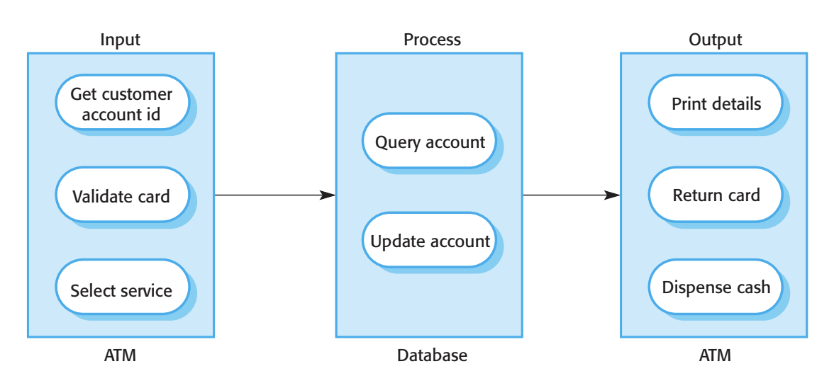
Example: Transaction Processing Systems

Slide 80
Information Systems
All systems that involve interaction with a shared database can be considered to be transaction-based information systems.
An information system allows controlled access to a large base of information, such as a library catalog, a flight timetable, or the records of patients in a hospital. Information systems are almost always web-based systems, where the user interface is implemented in a web browser.

Slide 81
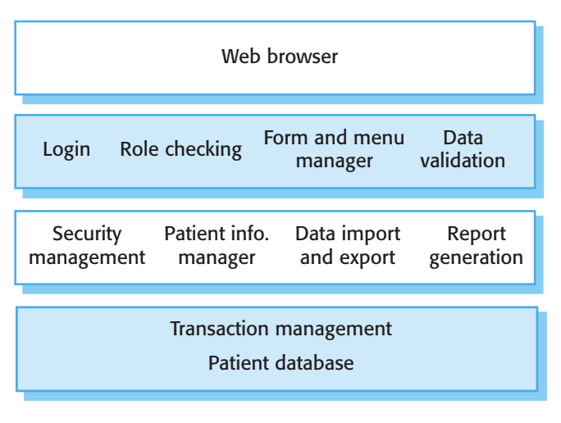
Example: The architecture of MentCare System

Slide 82
Language Processing System
Language processing systems translate one language into an alternative representation of that language and, for programming languages, may also execute the resulting code.
Compilers translate a programming language into machine code. Other language processing systems may translate an XML data description into commands to query a database or to an alternative XML representation.
Natural language processing systems may translate one natural language to another, for example, French to Norwegian.

Slide 83
Language Processing System..cont
Alternative Architectural patterns may be used in a language processing system (Garlan and Shaw 1993).
Compilers can be implemented using a composite of a repository and a pipe and filter model. In a compiler architecture, the symbol table is a repository for shared data.
This pipe and filter model of language compilation is effective in batch environments where programs are compiled and executed without user interaction; for example, in the translation of one XML document to another. It is less effective when a compiler is integrated with other language processing tools such as a structured editing system, an interactive debugger, or a program formatter.

Slide 84
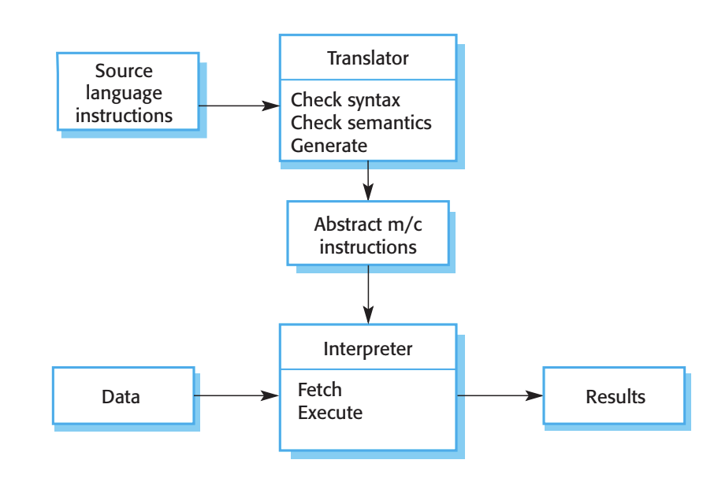
Example: Architecture of Language Processing System

Slide 85
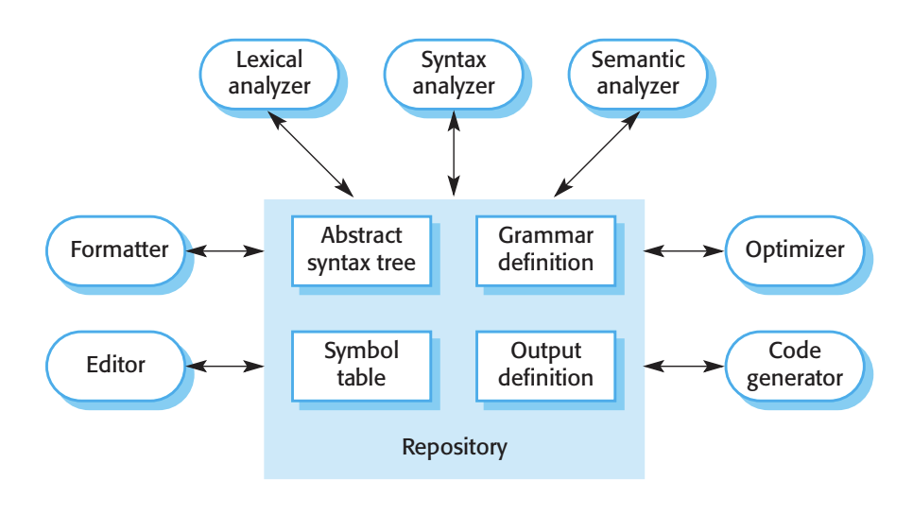
Example: Repository Architecture of Language Processing System

Slide 86
Example: Repository Architecture of Language Processing System
Programming language compilers that are part of a more general programming environment have a generic architecture (shown in Slide 84) that includes the following components:
  1. A lexical analyzer, which takes input language tokens and converts them into an internal form.
  2. A symbol table, which holds information about the names of entities used in the text that is being translated.
  3. A syntax analyzer, which checks the syntax of the language being translated. It uses a defined grammar of the language and builds a syntax tree.
  4. A syntax tree, which is an internal structure representing the program being compiled.
  5. A semantic analyzer, which uses information from the syntax tree and the symbol table to check the semantic correctness of the input language text.
  6. A code generator, which “walks” the syntax tree and generates abstract machine code.

Slide 87
Key Points
A software architecture is a description of how a software system is organized.
Architectural design decisions include decisions on the type of application, the distribution of the system, the architectural styles to be used.
Architectures may be documented from several different perspectives or views such as a conceptual view, a logical view, a process view, and a development view.
Architectural patterns are a means of reusing knowledge about generic system architectures. They describe the architecture, explain when it may be used and describe its advantages and disadvantages.

